Slide 1
User experience research
2022/12/10
Front-end development
Li Zhaozhi 李兆智

Slide 2

Table of contents
What is user experience (UX)?
What to consider in UX design?
How does UX design make an impact?
What is the workflow for UX design?
What resources are used for UX?
Front-end development
Li Zhaozhi 李兆智

Slide 3
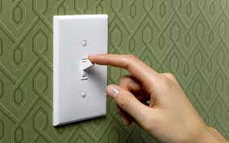


What is user experience (UX)?
User experience is how an user interacts with a product (digital / physical).
E.g.
Light: People switch to turn on or off the light or press a button.
App: People tap figurative buttons to navigate the app and do all sorts of things on the app.
Video: https://www.youtube.com/watch?v=9BdtGjoIN4E
Front-end development
Li Zhaozhi 李兆智

Slide 4
What to consider in UX design?
It’s about how users think and feel.
Value
Function
Does this product add any value?
Does the function work?
Usability
Impression
Is the product easy to use?
Is the overall experience pleasant?
Front-end development
Li Zhaozhi 李兆智

Slide 5
What to consider in UX design? (cont...)
It’s about how users think and feel.
Usable:
A product needs to be simple, easy to use, and familiar.
Useful:
A product must fill a need. If the product isn’t filling a perceived gap in the users’ lives, then there is no real reason for them to use it.
Desirable:
The visual aesthetics of the product need to be attractive and evoke positive emotions.
Findable:
If the user has a problem with a product, they should be able to quickly find a solution.
Accessible:
The product or service needs to be accessible to everyone, including those with disabilities.
Credible:
The company and its products need to be trustworthy.
Front-end development
Li Zhaozhi 李兆智

Slide 6
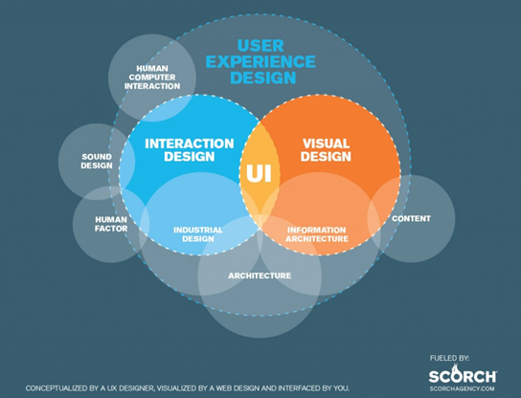
What to consider in UX design? (cont...)
It’s about how users think and feel.
Front-end development
Li Zhaozhi 李兆智

Slide 7
How does UX make an impact?
Nokia lost the market to Apple because when iPhone introduced the touchscreen experience, it transformed customers’ user experience expectations. Nokia was slow in adapting to the change.
User experience is more than usability and user interface. It is about serving the needs of people and business. And, it is an ongoing process. With feedback received from users the design could change over time to meet new expectations.
As user experience is the impression of users from interacting with products, it cannot be designed. User experience designers; therefore, are designing the elements for that experience in hope that users could get more positive experience with the product or service.
Front-end development
Li Zhaozhi 李兆智

Slide 8
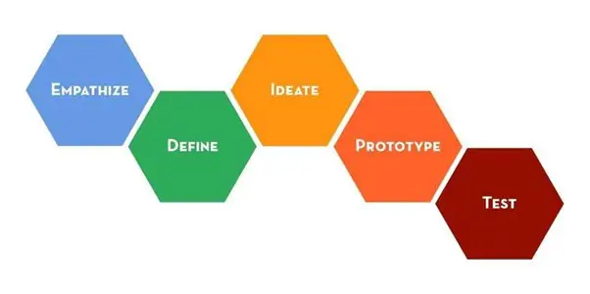
User experience design workflow
Iterative process: Think make and check.
Design thinking: 5-step process
Front-end development
Li Zhaozhi 李兆智

Slide 9
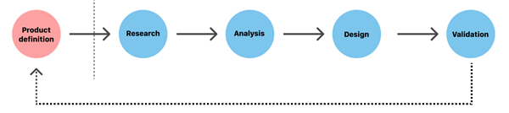
User experience design workflow (cont..)
Test the concept:
Internal test: Team members test regularly to identify flaws.
External test: Test with users to collect feedback.
Surveys: Hand out surveys to collect user feedback.
Analysis: Analyse survey data to improve.
Research product context:
Stakeholder interviews: Business goals
Value proposition mapping: Match user and business needs.
Concept design: Mockup design
Research product context:
Indepth interview: Understand stakeholder needs, expectations.
Competitive research: Understand industry standards and identify opportunities.
Analyse data to retrieve actional insights.
User profiles: Create fictious profiles to represent different people.
User stories: View from user’s point of view.
Storyboard: Connect profiles with stories.
Design based on research:
Sketch: Sketch to visualise the design.
Wireframe: Fully featured design of the product.
Prototype: Interactive design to simulate the end product.
Specifications: Specify design standards and requirements.
Design system: Reusable design elements following the same specifications.
Front-end development
Li Zhaozhi 李兆智

Slide 10
References
What You Should Know About User Experience Design, Nick Babich, Nov 24, 2022, Adobe Xd Ideas [webpage] https://xd.adobe.com/ideas/career-tips/what-is-ux-design/
The UX Design Process: Everything You Need to Know, Nick Babich, Nov 24, 2022, Adobe Xd Ideas [webpage] https://xd.adobe.com/ideas/guides/ux-design-process-steps/
Also read the literature on user experience and design thinking.
Front-end development
Li Zhaozhi 李兆智

